Slide 1


Slide 2
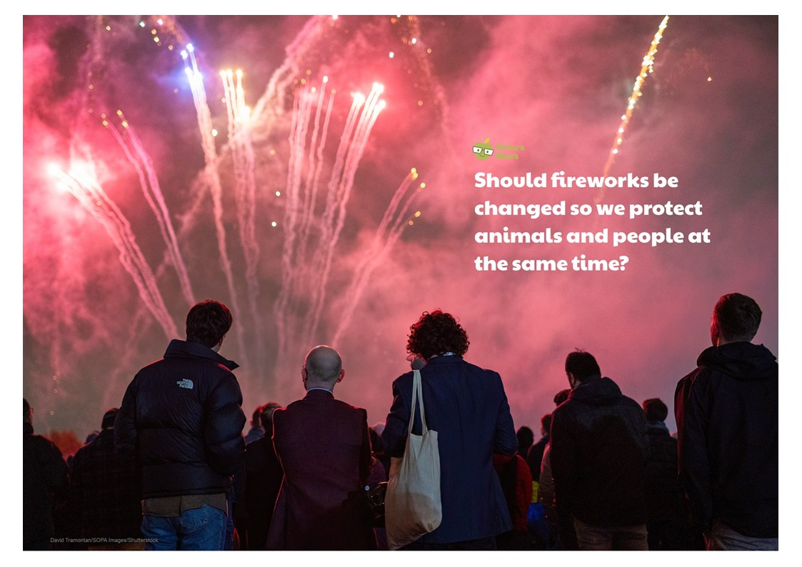

Slide 3
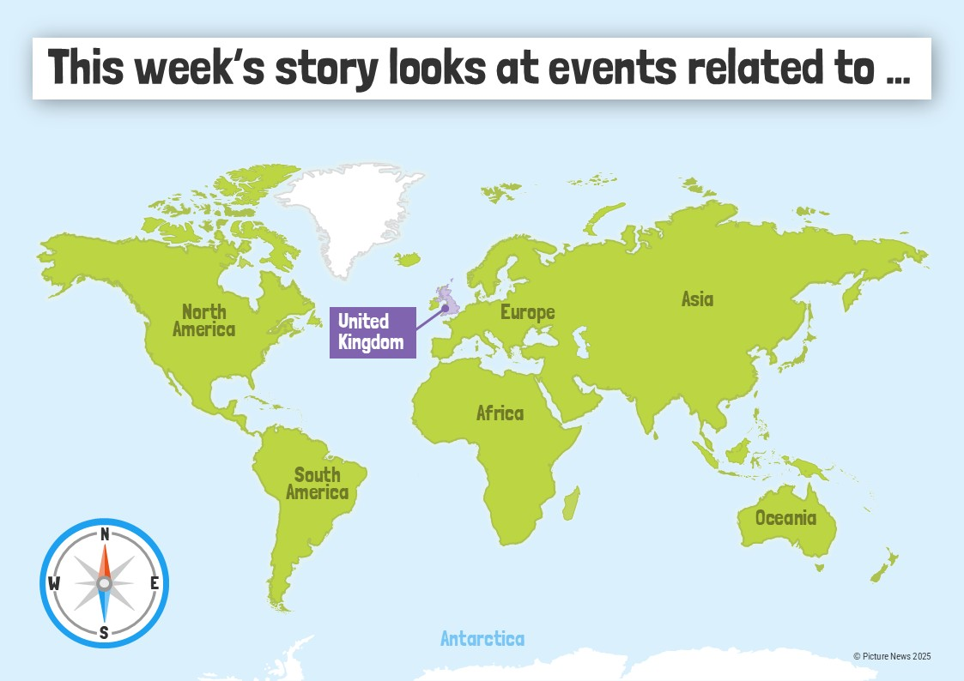

Slide 4
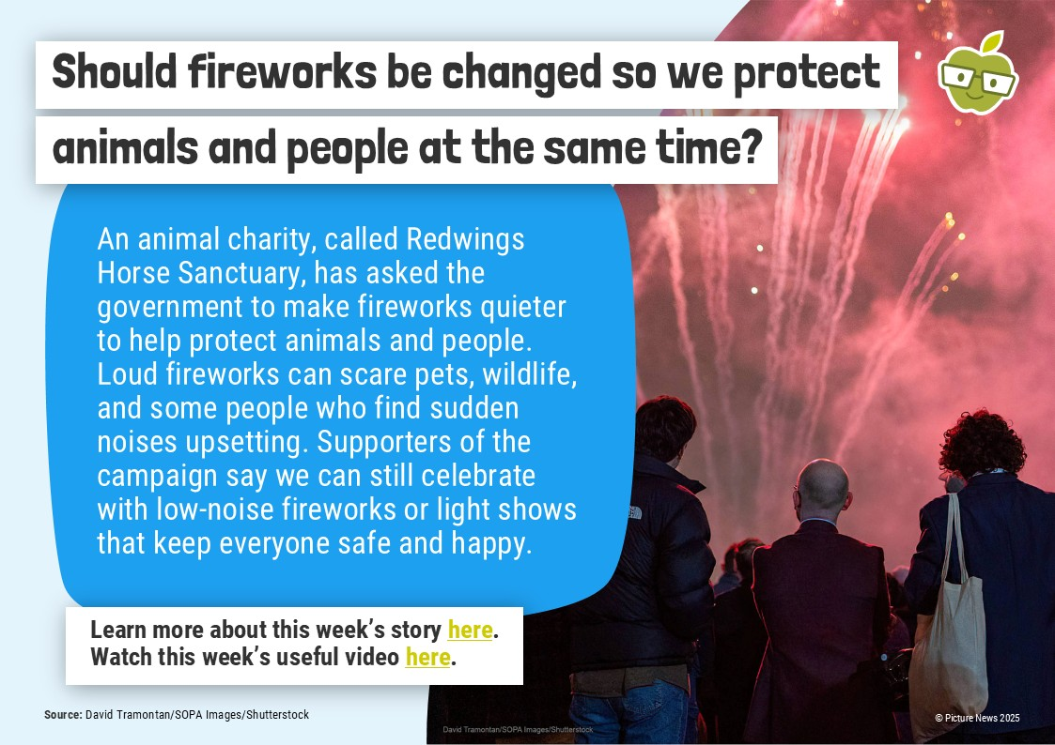
Watch me

Slide 5
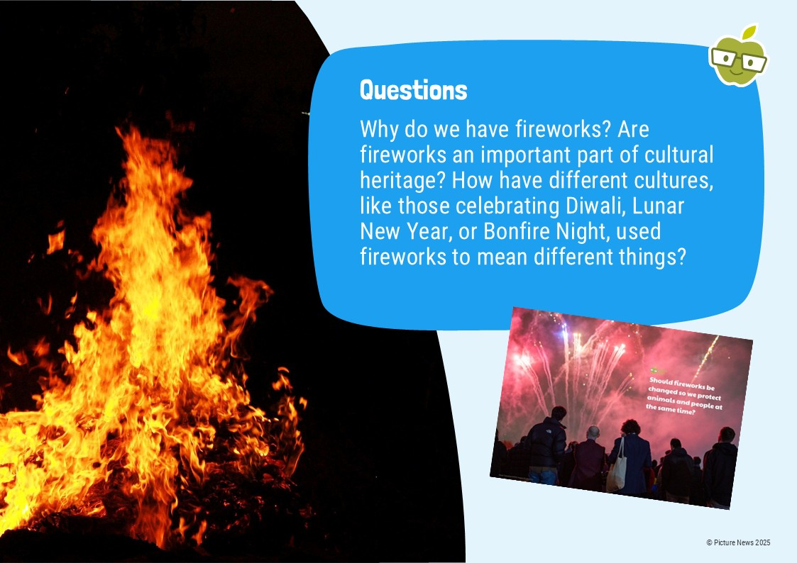

Slide 6
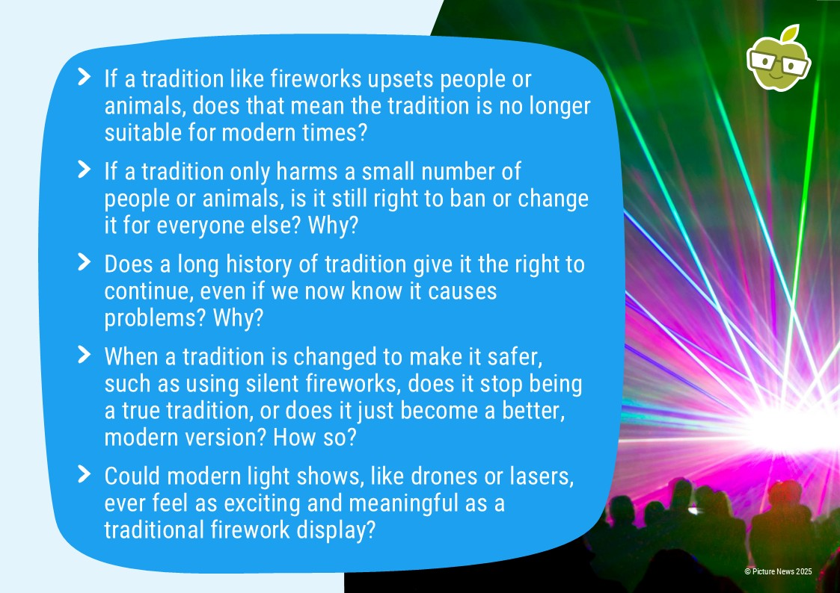

Slide 7
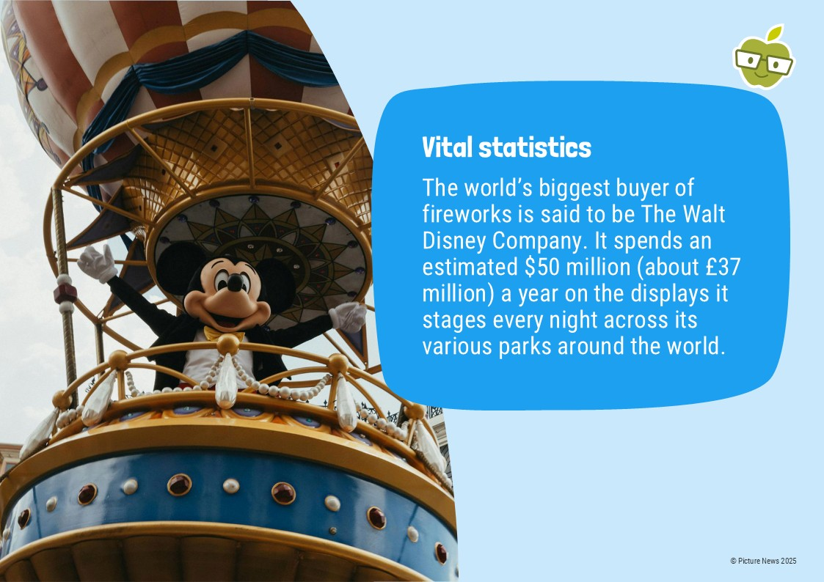

Slide 8
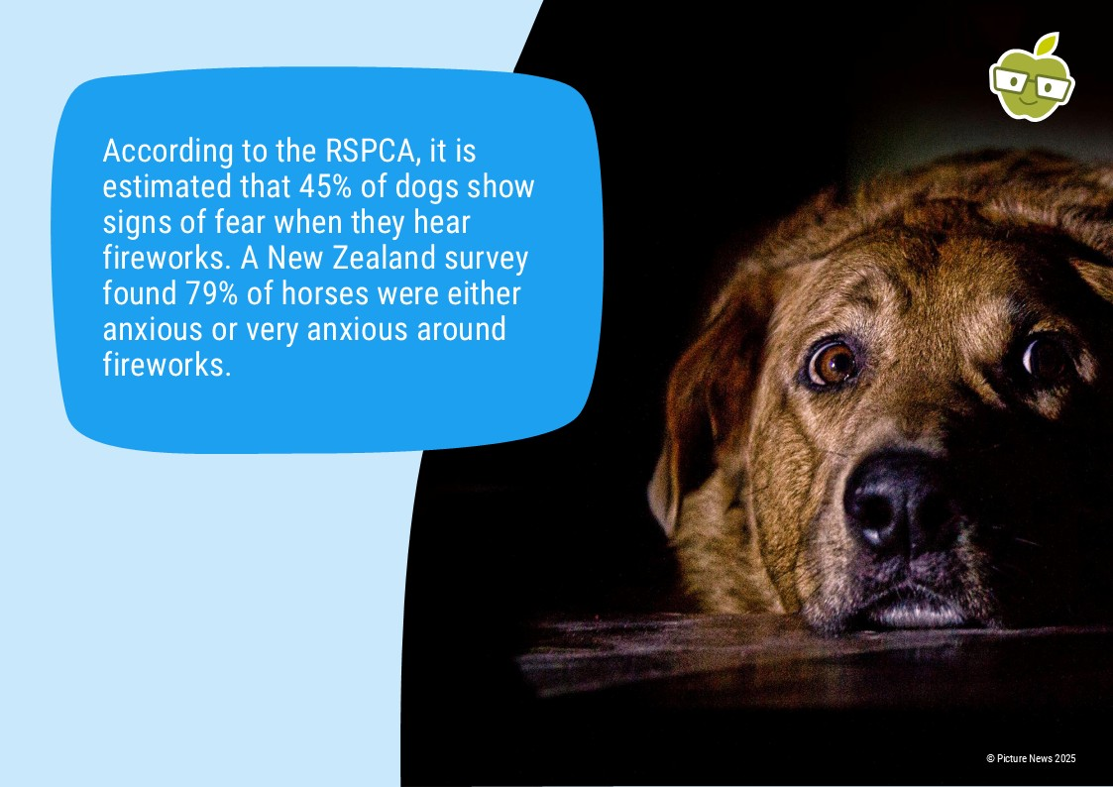

Slide 9
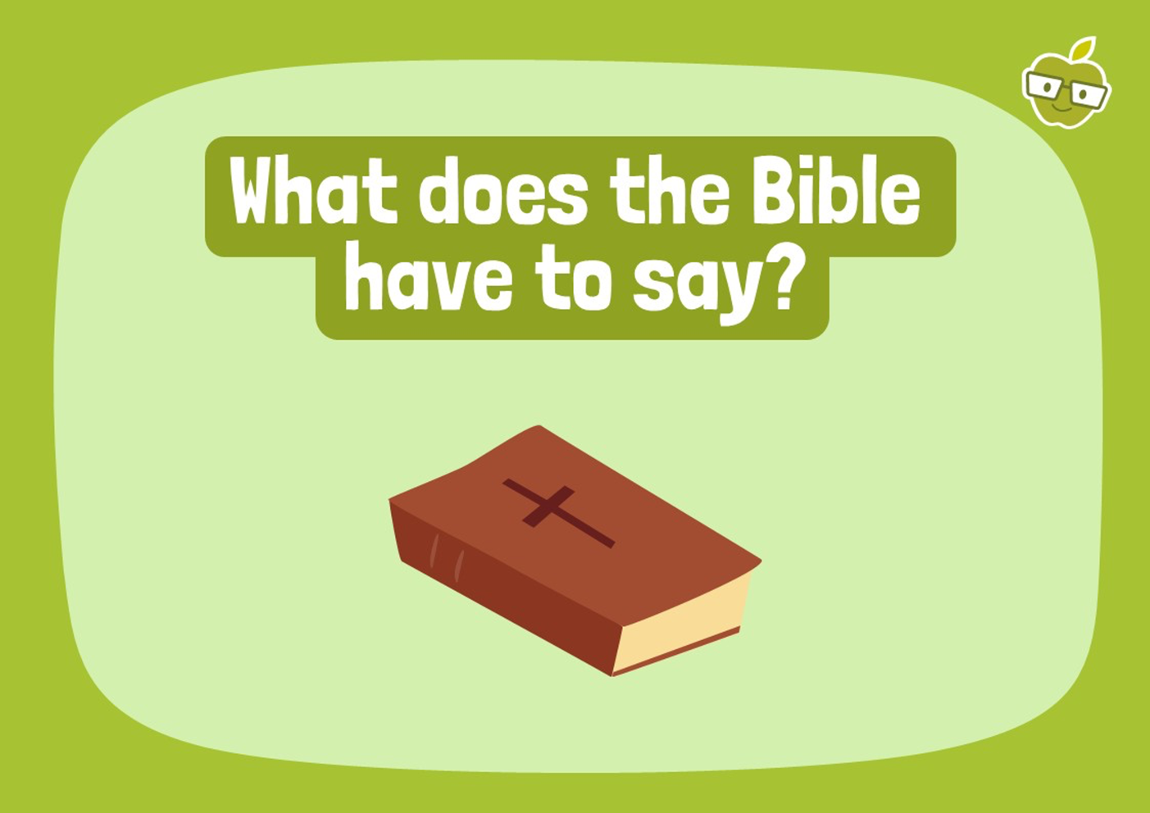
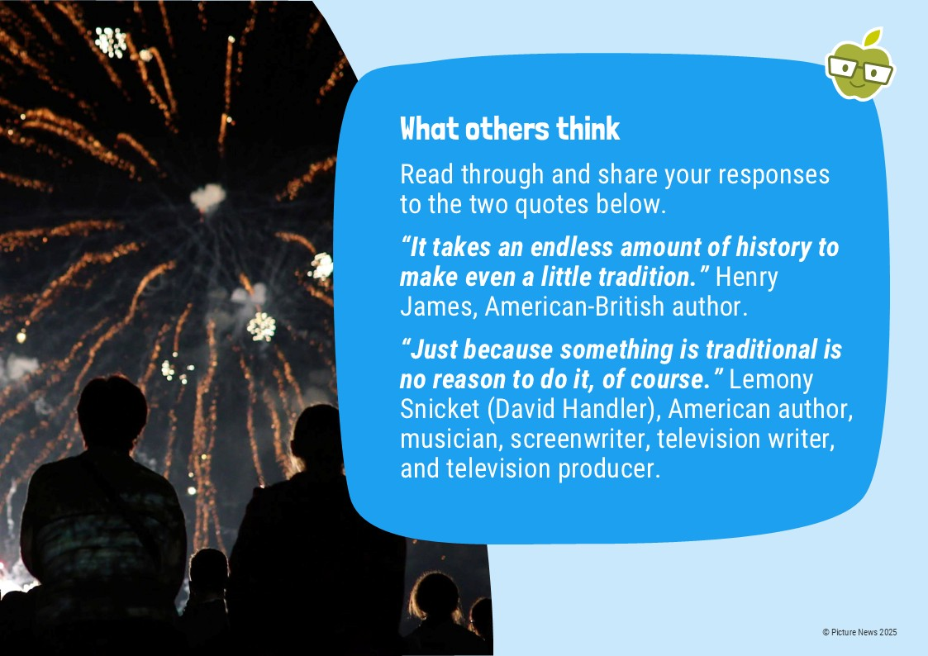

🐶 Fireworks and Pets: A Christian Perspective 🐾
The Christian concept of dominion (Genesis 1:28) does not mean humans can exploit creation, but rather calls us to responsible stewardship, caring for the world and all its creatures, including pets.
This means we should consider the distress caused to animals—many of whom become terrified by loud bangs—when choosing to use fireworks.
Therefore, acting as good stewards, we show our love for God the Creator by making choices that protect and ensure the well-being of the pets He has entrusted to our care.

Slide 10


Slide 12


Slide 13


Slide 14
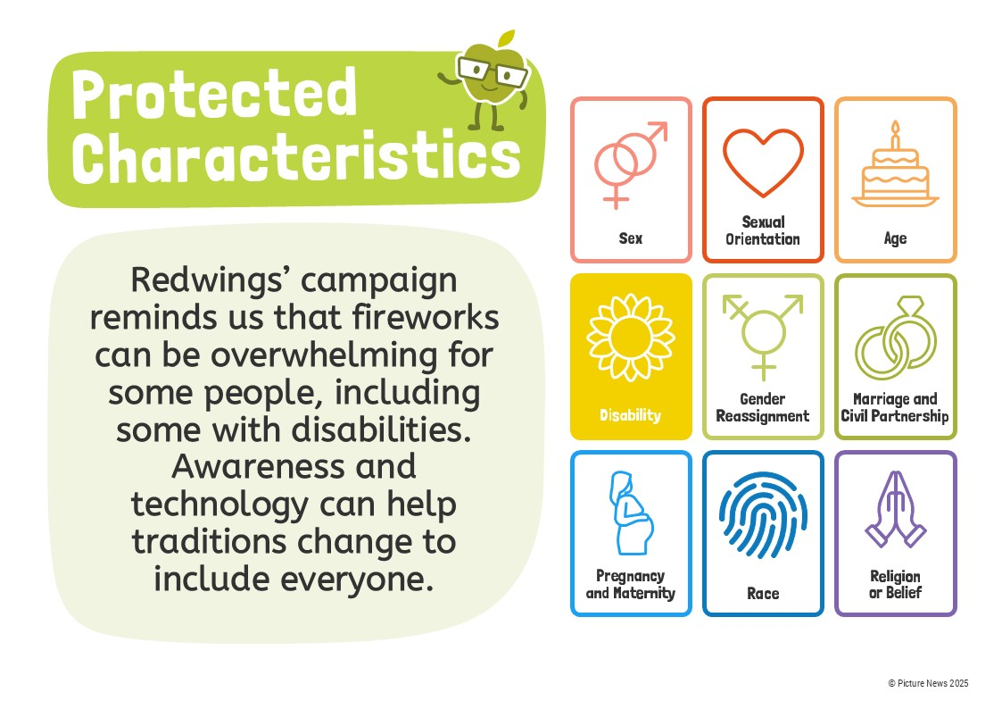

Slide 15


Slide 16
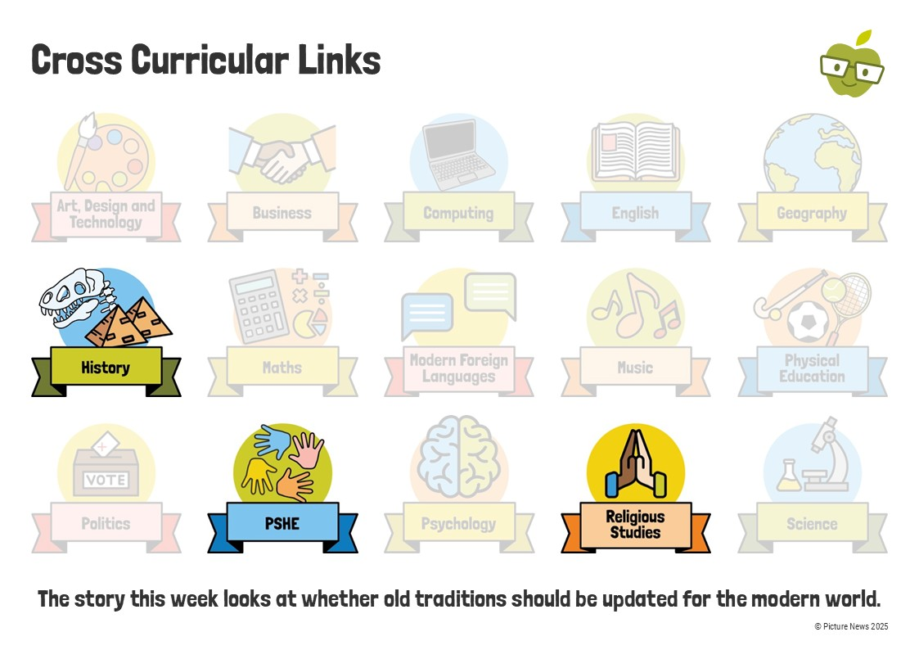

Slide 17
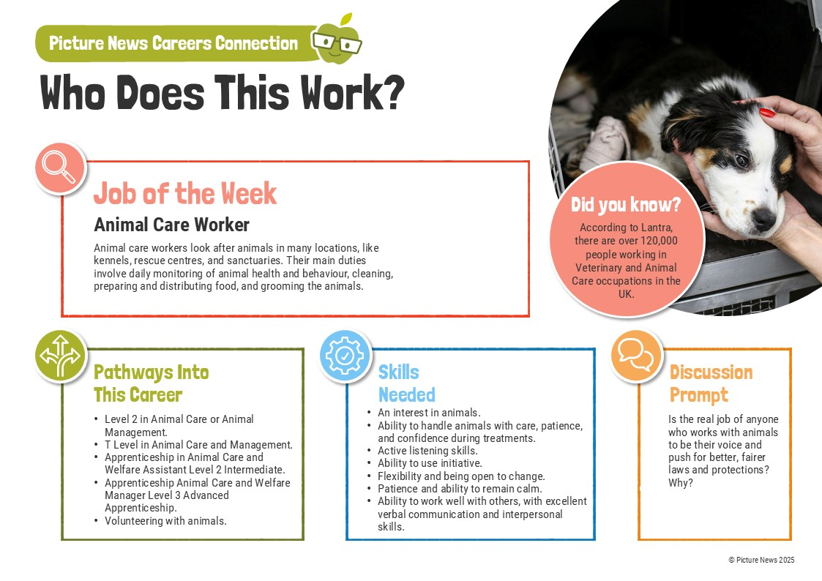

Slide 18


